Slide 1
BORDERED RUBBER DAM CLAMP
MAHALAKSHMI.K
I MDS
DEPARTMENT OF PUBLIC HEALTH DENTISTRY

Slide 2
BACKGROUND OF THE INVENTION
First described by Dr Barnum over 150 years ago, rubber dam isolation ought to have its place defnitively within our restorative armamentarium now more than ever before.
It acts as a physical barrier between the selected operator field and the oral cavity, which prevents saliva, blood, gingival crevicular fluid, humid exhaled air, and other debris from interfering with the restorative treatment.
When correctly inverted, it successfully retracts the gingivae, thereby allowing improved access to deep interproximal carious
It eliminates the risk for potentially harmful dental materials, chemicals (notably, sodium hypochlorite), and small instruments from being ingested into the gastro-intestinal tract
It provides an aseptic field during endodontic

Slide 3
DISADVANTAGES OF A CONVENTIONAL RUBBER DAM
Inadequate retention of the rubber dam on molars: This arises because of the great amount of tension created when the rubber sheet is stretched onto the frame.
This tension, in turn, can exert such a tug on the rubber dam clamps that, under adverse conditions, the whole rubber dam can spring loose.
Contraindicated in cases where the patients have latex allergy and Asthma.
Cumbersome to use in patients with macroglossia.
Psychological factors can also play a significant role with the use of rubber dam.

Slide 4
SUMMARY OF THE INVENTION
To overcome the above mentioned problems, a novel bordered rubber dam clamp has been designed.
The rubber dam clamp needs to engage the tooth at certain critical contact points.
The clamp is meant primarily for retention of the rubber dam, which it does through its spring action below the height of contour of a tooth.
It may also help to slightly retract the gingiva.

Slide 5
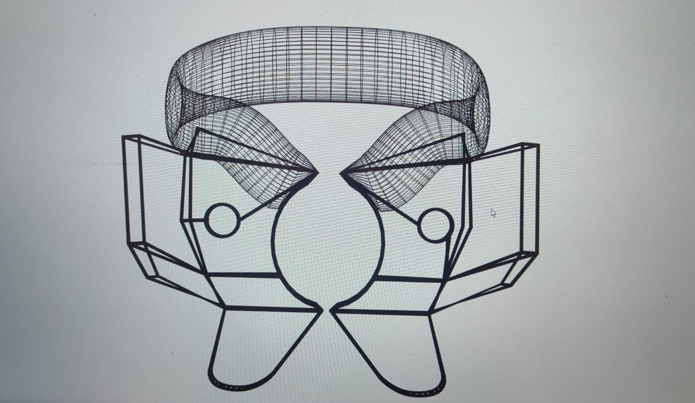
DESIGN OF THE INVENTION
The design consists of a metal plate that would be soldered to the base of the beak on the buccal and lingual side .
The metal plate will continue as a flat surface followed by which it will extend coronally at an angle of 45 degree to the flat part of the metal plate

Slide 6
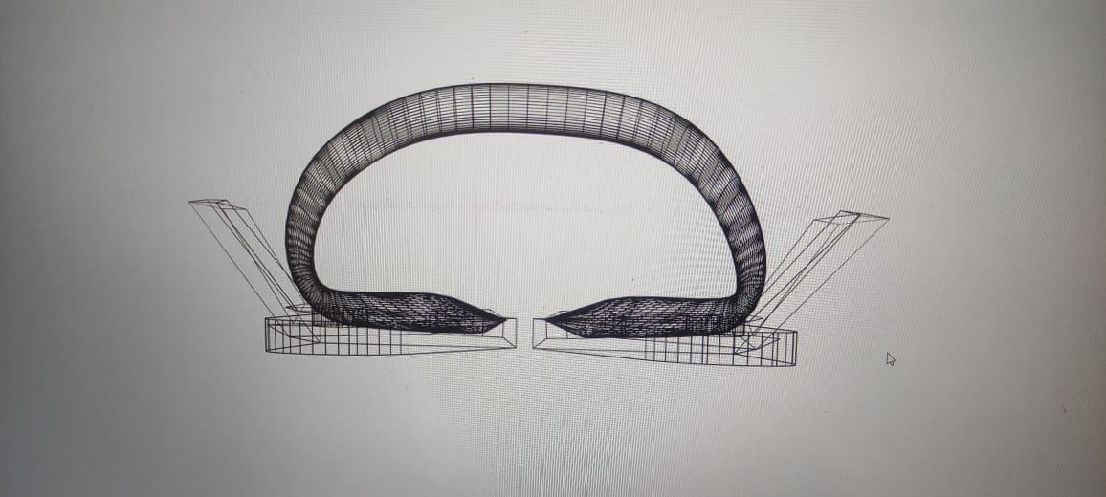
ADVANTAGES OF THE INVENTION
The coronal angulated extension will act as an effective barrier in order to obtain an isolated field of operation.
The extension on the lingual side will retract the tongue thereby preventing tongue interference and saliva contamination from the lingual side.
This can prove to be beneficial in patients with macroglossia.
The extension on the buccal side will retract the buccal soft tissues thereby preventing its impingement on the operative field.

Slide 7
CONCLUSION
Hence , a barricaded, dry ,isolated field of operation is created by the extensions on either side which form a barrier around the tooth thus eliminating the need for a rubber dam sheet.
This invention can act as a valuable addition to the restorative armamentarium in certain special circumstances where use of a rubber dam sheet is inconvenient or contraindicated.
Moreover use of a clamp alone with a dam can be time saving , patient friendly and convenient for the operator as well.

